Slide 1
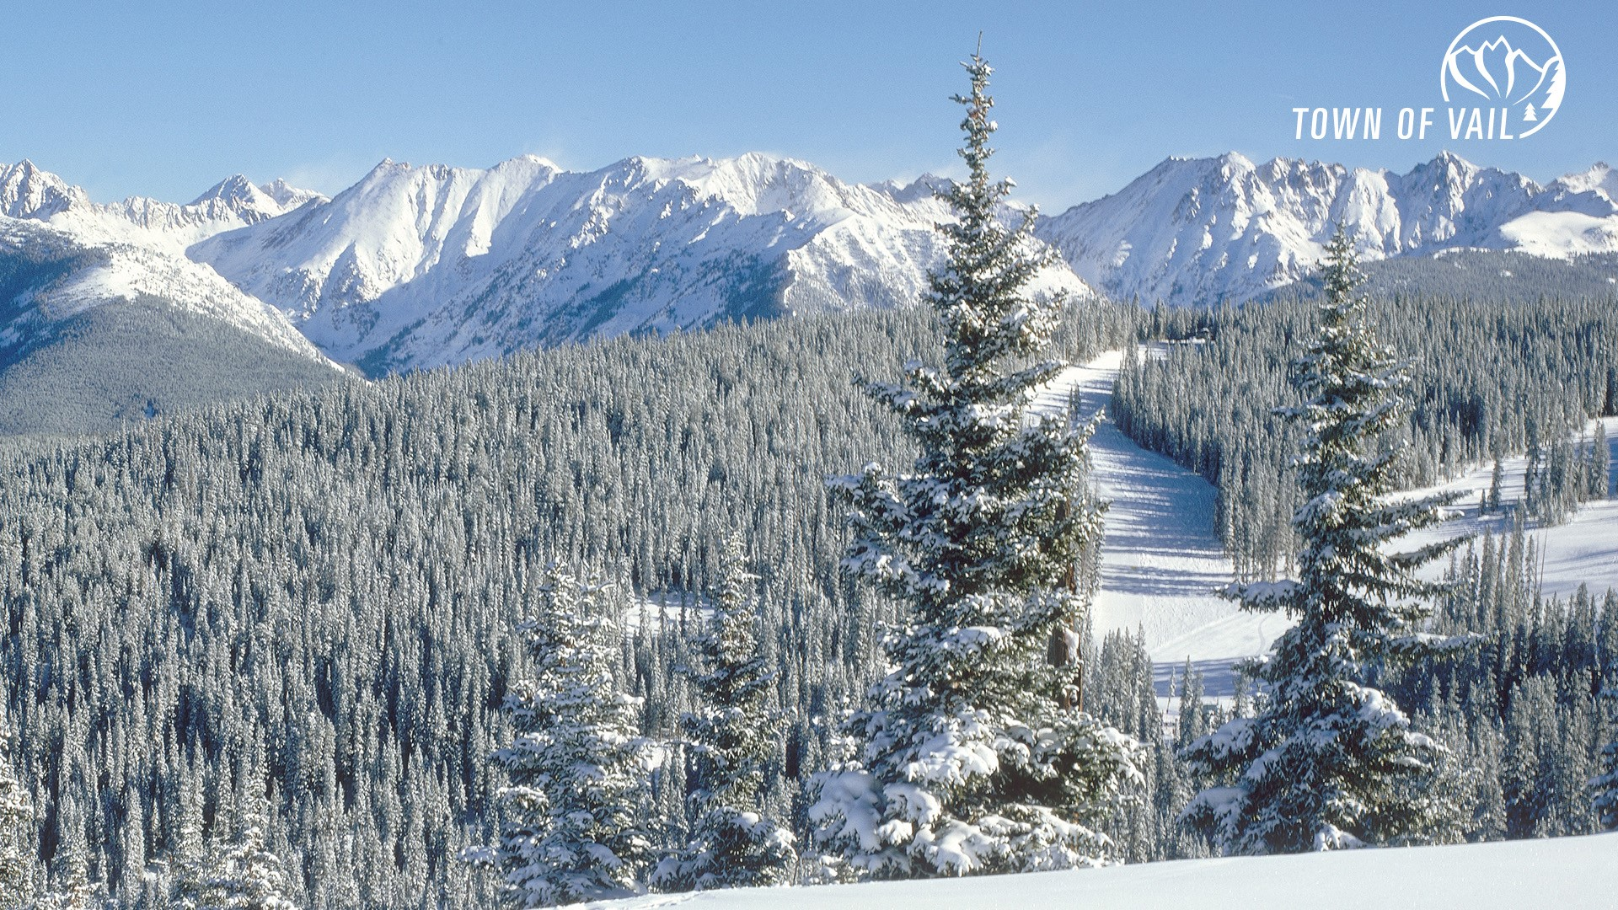
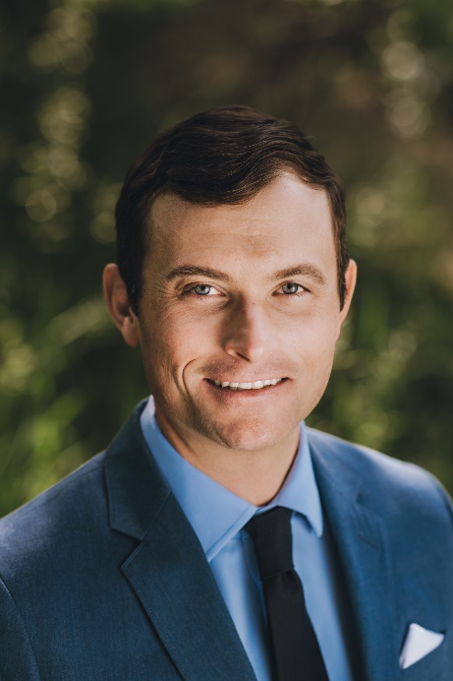

Geothermal Heating as a Clean Energy Solution
for Reducing Mountain Town Emissions
2024 Climate Solutions Summit, Jackson Wyoming
Cameron Millard, Clean Energy Specialist
Dept. of Environmental Sustainability, Town of Vail
Matt Garlick CCP, CEM, BEMP
Managing Member , The GreyEdge Group

Slide 2
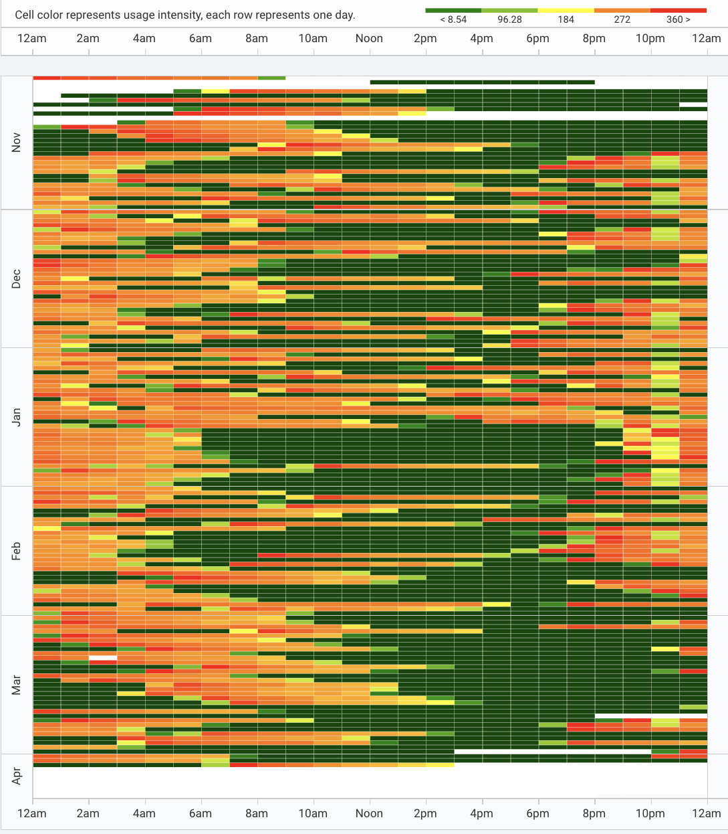
Vail’s Decarbonization Journey
Vail climate goals (50% by 2030, 80% by 2050)
Snowmelting 80% of municipal natural gas useage
Snowmelt creates 6,500 metric tons of C02 annually
440 KW electric boiler in 3rd year of operation
Gas system equal to 7 megawatts
Electric resistance can work, but at what cost (3.31x)
Vail Electric Snowmelt Boiler Heat Map
Notes:
Also: Ease peak load demand
Turn liabilities into assets
Create new business models around energy
Shift paradigms about how energy is created, transferred, and shared

Slide 3
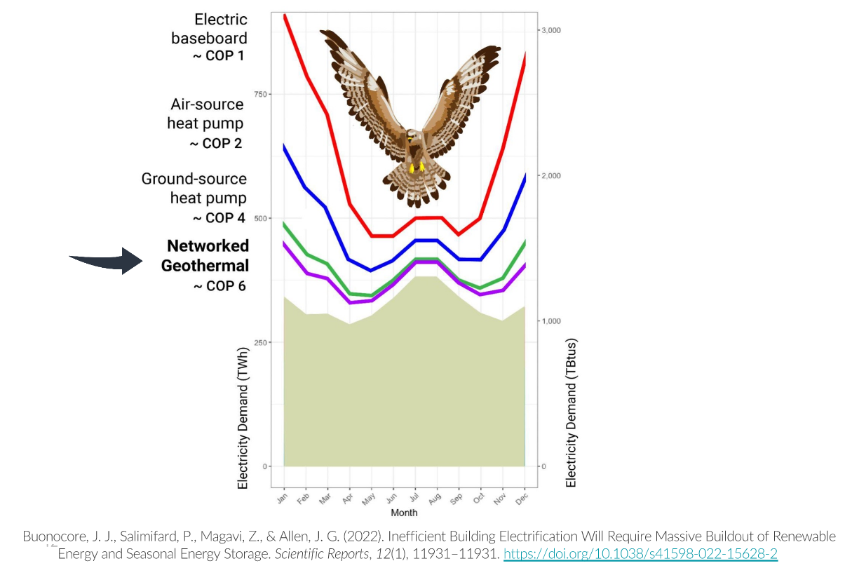
Grid Decarbonization
The last 10% will be the hardest
Mountain towns have unique challenges
Building electrification and EV charging
are also putting demands on energy
supply
Efficient electrification is needed to scale
decarbonization, i.e. the Falcon Curve

Slide 4
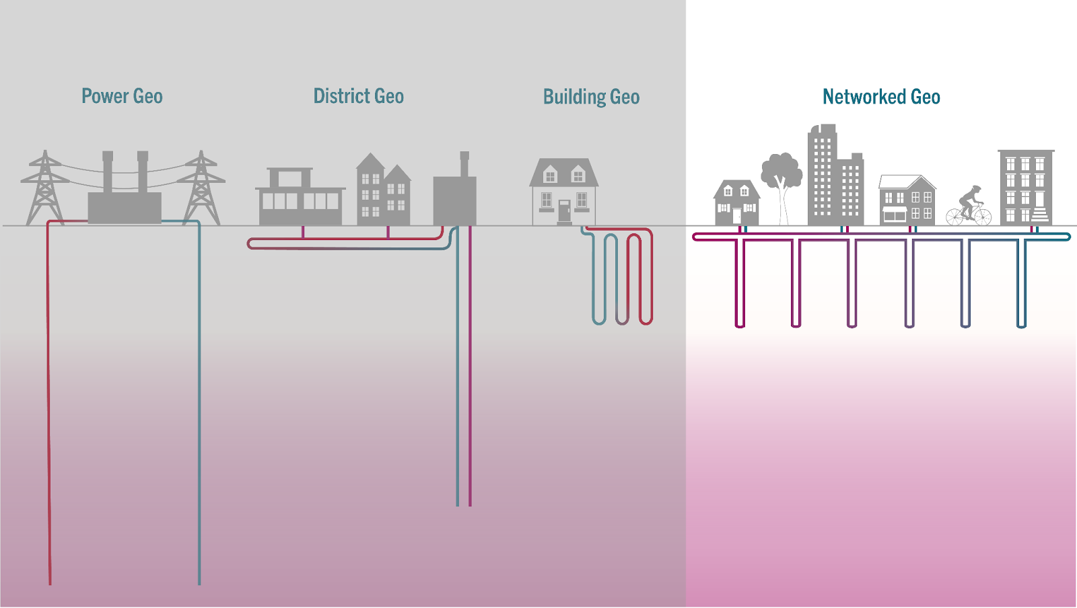
Thermal Energy Networks (TEN) and Networked Geo
Thermal Energy Network
Image Credit: HEET
Notes:
ATL 101: Heat pumps to Heat Pump Buildings Heat Trading enabled. Can be connected to air, water, or ground.
Networked buildings (the TEN)
Move heat from lab to classroom, from civic buildings to residential
(insert graphic)
3 components
Buildings
Loop
Thermal management devices

Slide 5
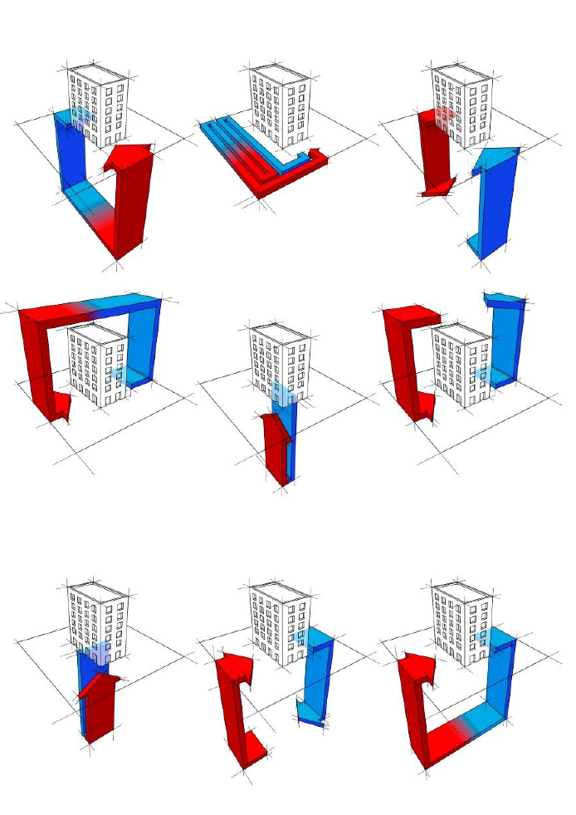
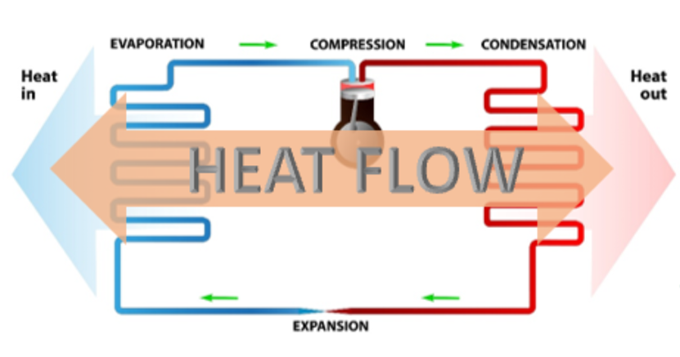
Heat Pump Systems
Notes:
System expansion and growth over time. Modularity of system is a huge benefit. Increased resiliency comes with expansion and diversity

Slide 6
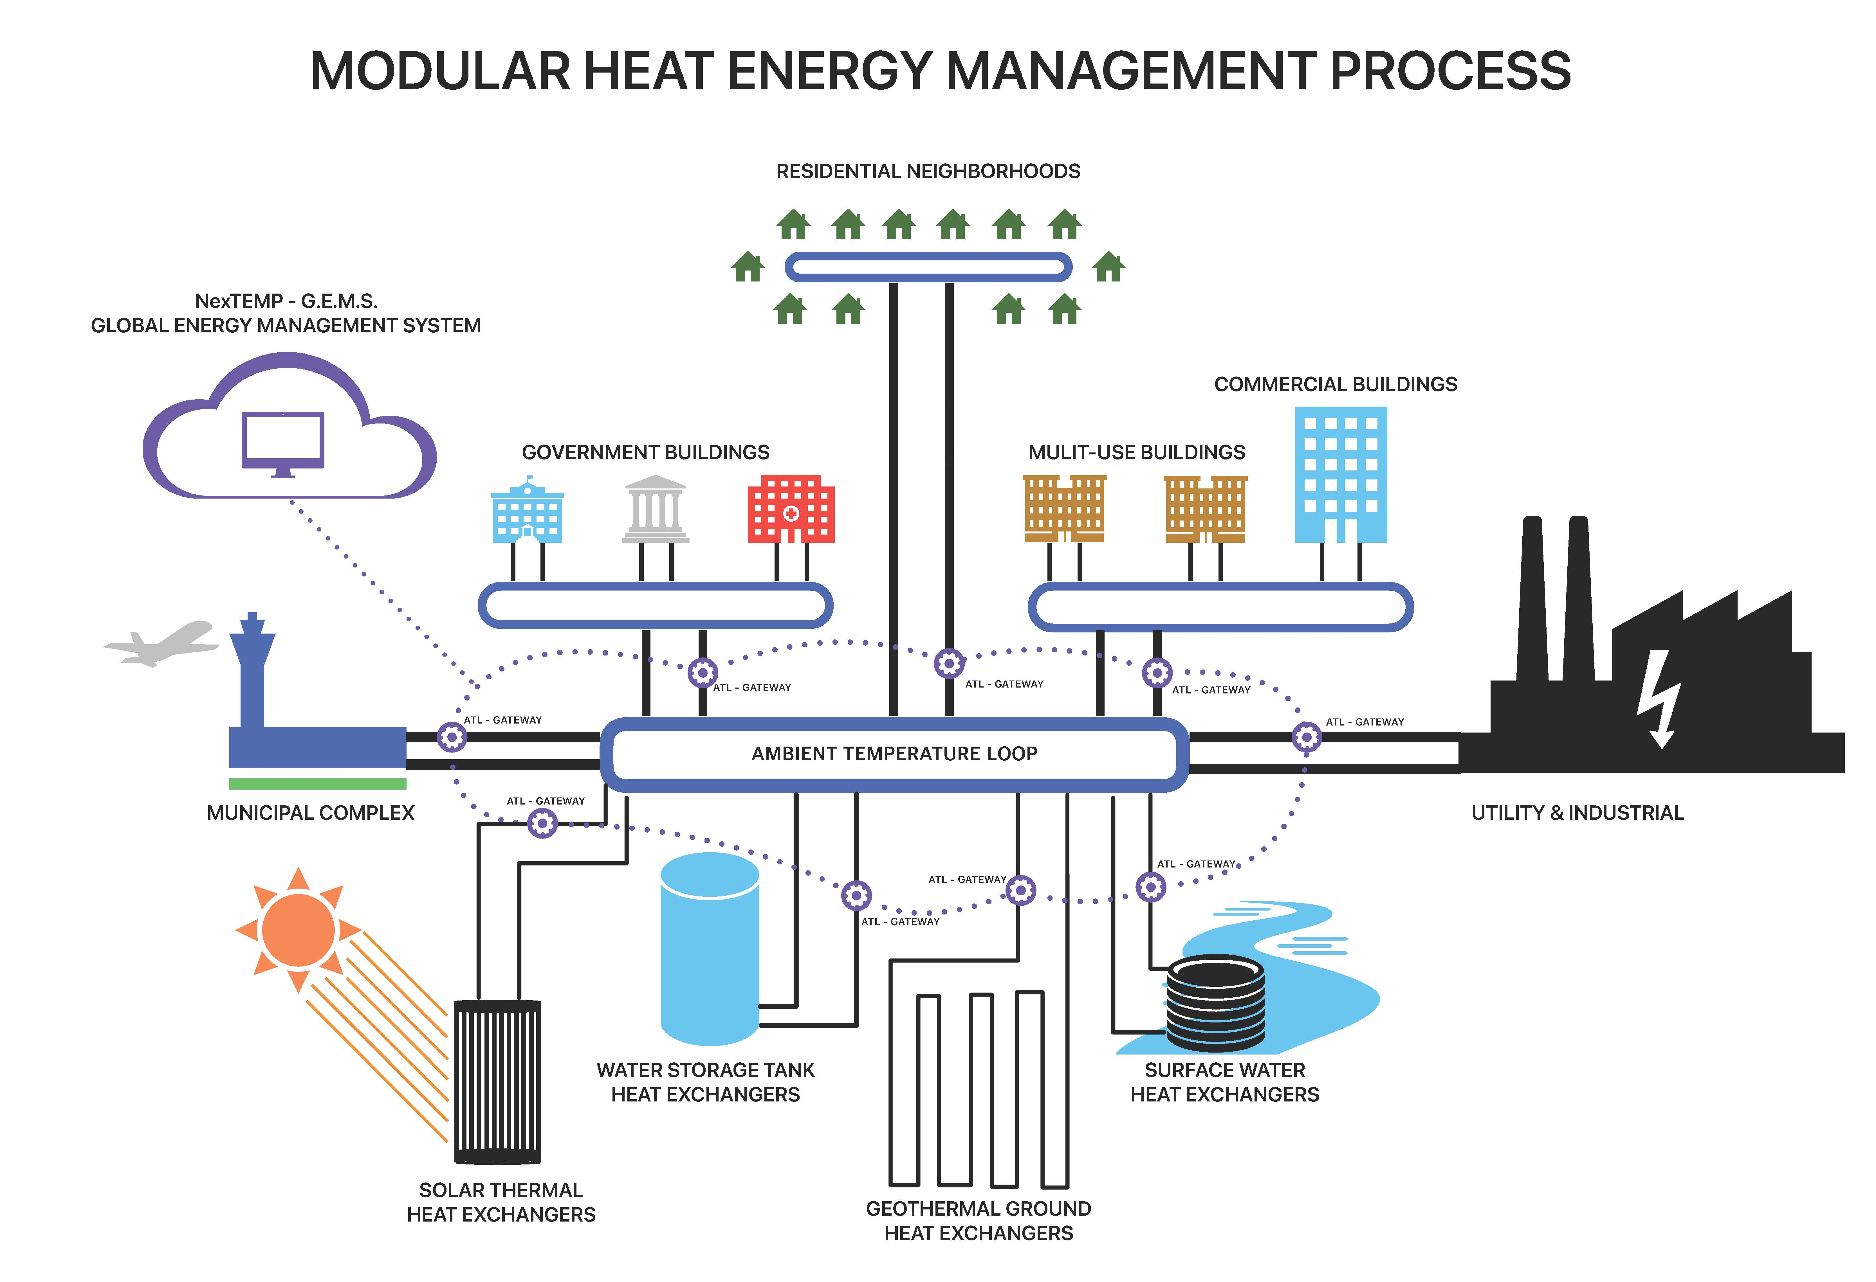
The Ambient Temperature Loop
Notes:
Networked Buildings
Shared Loads and Assets
Liabilities can become Assets

Slide 7
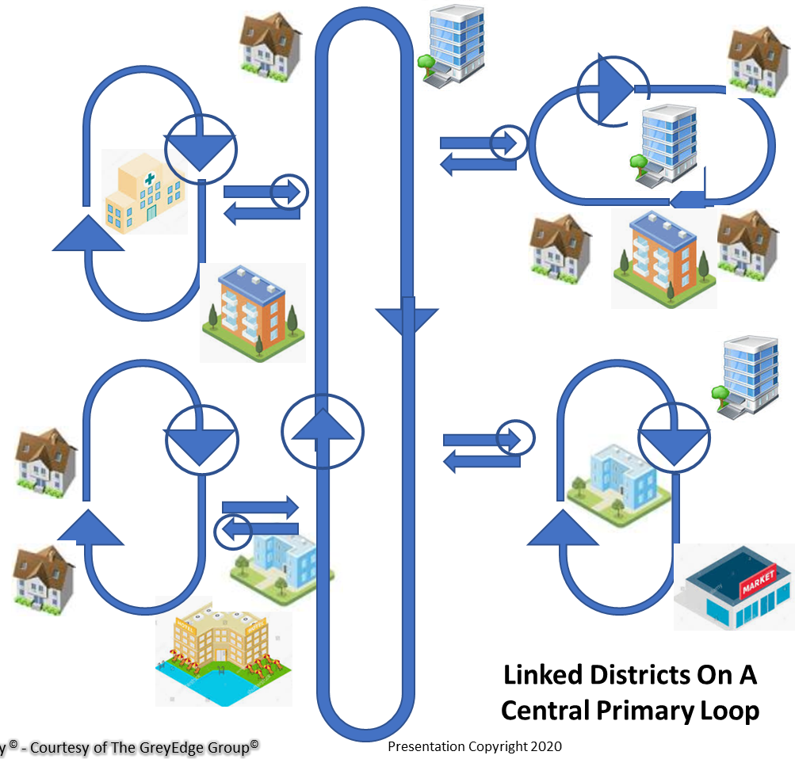
ATL Microgrids
Notes:
System expansion and growth over time. Modularity of system is a huge benefit. Increased resiliency comes with expansion and diversity

Slide 8
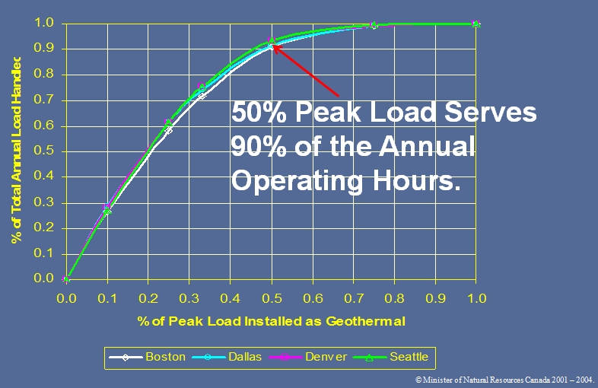
Hybrid Systems – The 50/90 Rule

Slide 9
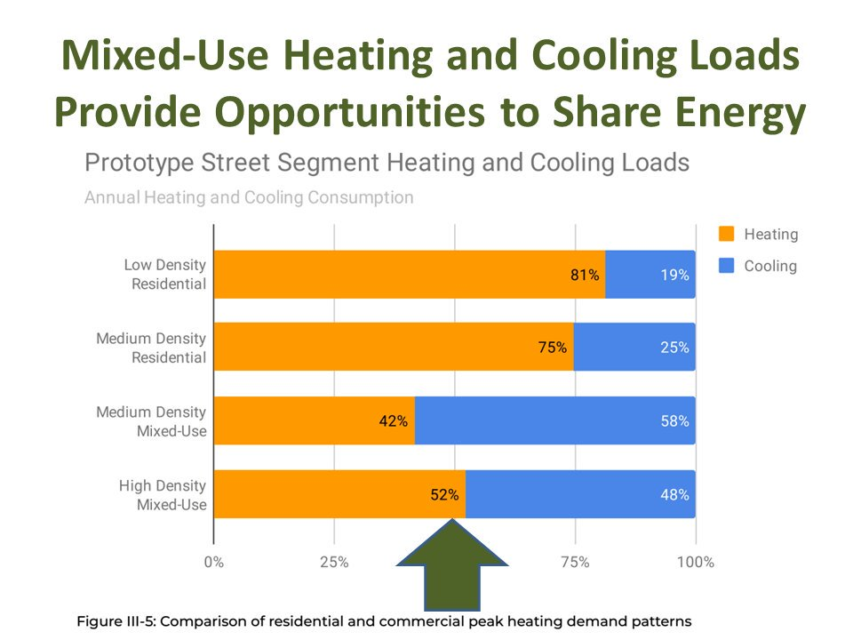
The Value of System Diversity

Slide 10
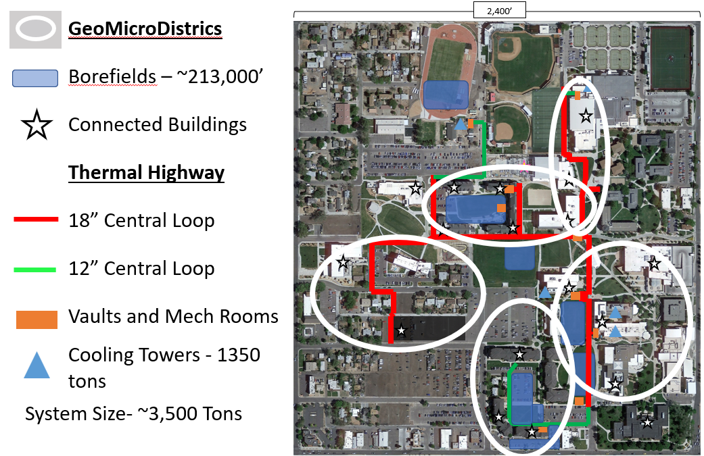
Case Studies- Colorado Mesa University

Slide 11
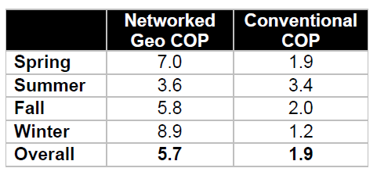
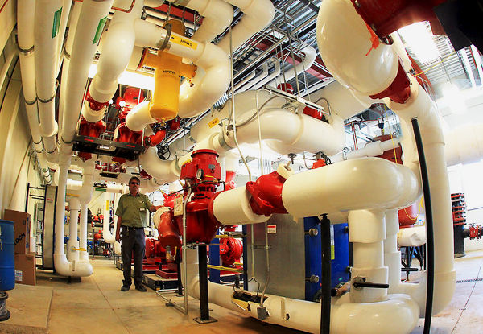
Case Studies- Colorado Mesa University
Without District System:
217 vertical feet of borehole per installed ton
Calculated water use: 14.5MM gallons/yr. (3,400 tons CT)
Electric Load 784 kW
With District System:
84 vertical feet of borehole per installed ton
Estimated Water Use: 4.5MM gallons (705 tons CT)
Electric Load: 185 kW
>$2,000,000 in annual utility savings

Slide 12
Electric Demand Response
Notes:
Thermal inertia is related to system size and mass
Ability to coast through peak events
CMU has 12 levels of demand response and
can hit button in response to XCEL Energy peak demand calls (Matt insert _______ here)

Slide 13
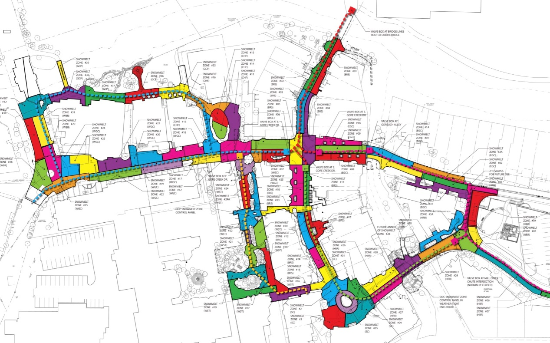
The Vail Decarbonization Challenge
Largest snowmelt in North America?
System performance a must!
Peak load is late afternoon or snow events, so during peak or random
Snowmelting is highly energy intensive
Electric resistance is expensive
Buildings are also part of the puzzle.
Notes:
(Vail snowmelt system map graphic)
Biggest snowmelt in north America (12 acres), 7megawatts of equivalent electrical energy (size of snowmelt plant
(insert pic)
Existing system serves town in many ways (slip and falls, snow storage and removal, cater to demographic that expects dry pavers (high-heel grade), risks for litigation
Covers Vail Village and Lionshead
Runs hot, was recently retro-commissioned (we are making more efficient)

Slide 14
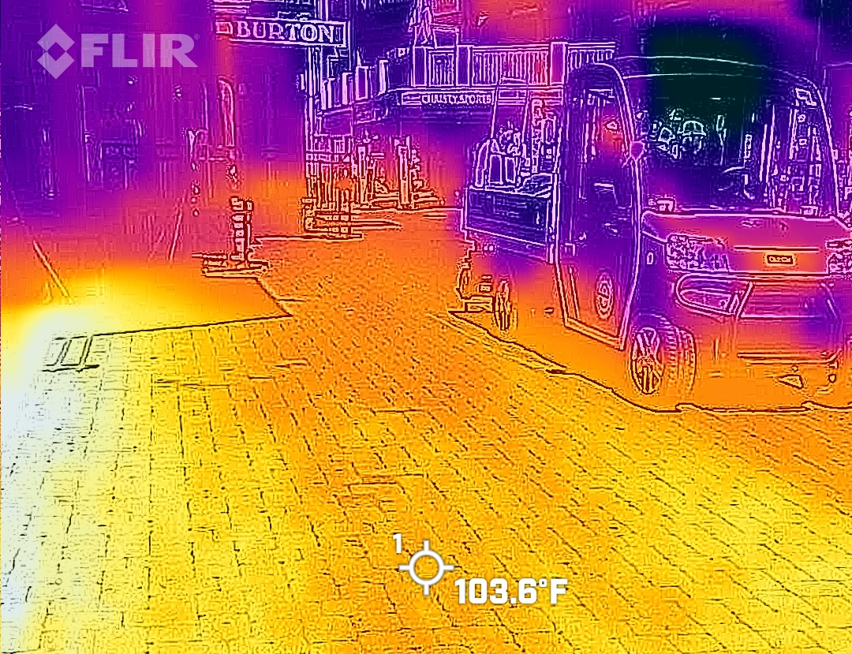
Energy and Carbon Reduction Potential in Vail
Notes:
Vail is pursuing efficiency to reduce emissions, but to achieve goals we must reconsider the energy system type itself (equipment, fuel source, holistic opportunities). Benefit of efficiency is smaller alternative. Vail is pursuing both/and/all-of-the-above solutions.

Slide 15
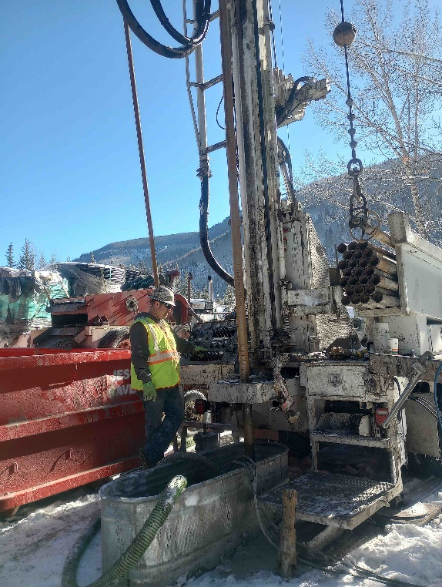
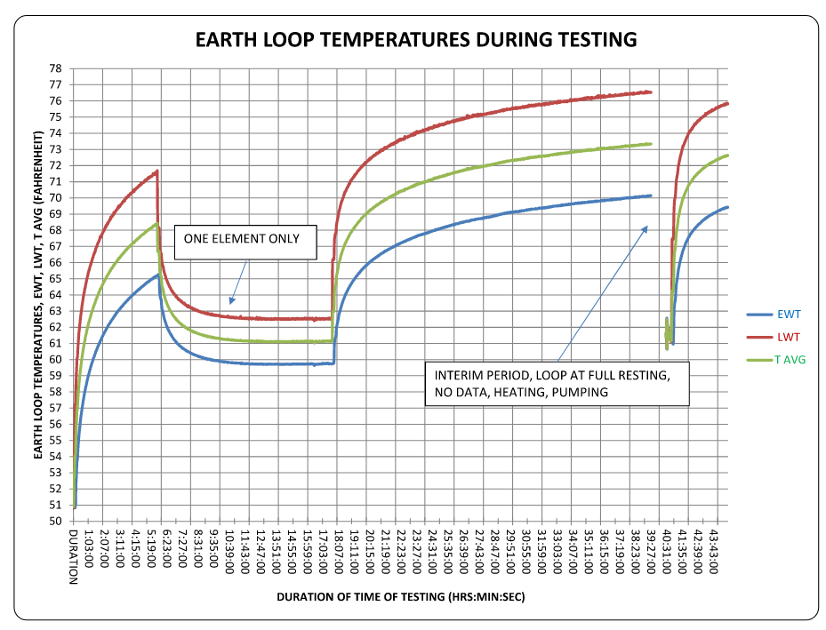
Thermal Energy Network Study- Phase 1
Initial Feasibility Study
50/90 decarbonization rule
Hydrogeology
Test Borehole
Thermal sources
Notes:
We conducted an advanced thermal conductivity test which involves pulsing heat into the ground and observing the rate of dissipation. This helps us understand the thermal battery potential of our geology (how quick to charge and discharge, and how long to store heat). (ability to transfer and store heat easily)
Similar conditions throughout valley floor
Evaluation of sources of thermal energy
ATL 101: Heat pumps to Heat Pump Buildings
Heat Trading enabled
Can be connected to air, water, or ground
Networked buildings (the TEN)
Move heat from lab to classroom, from civic buildings to residential
(insert graphic)
3 components
Buildings
Loop
Thermal management devices

Slide 16
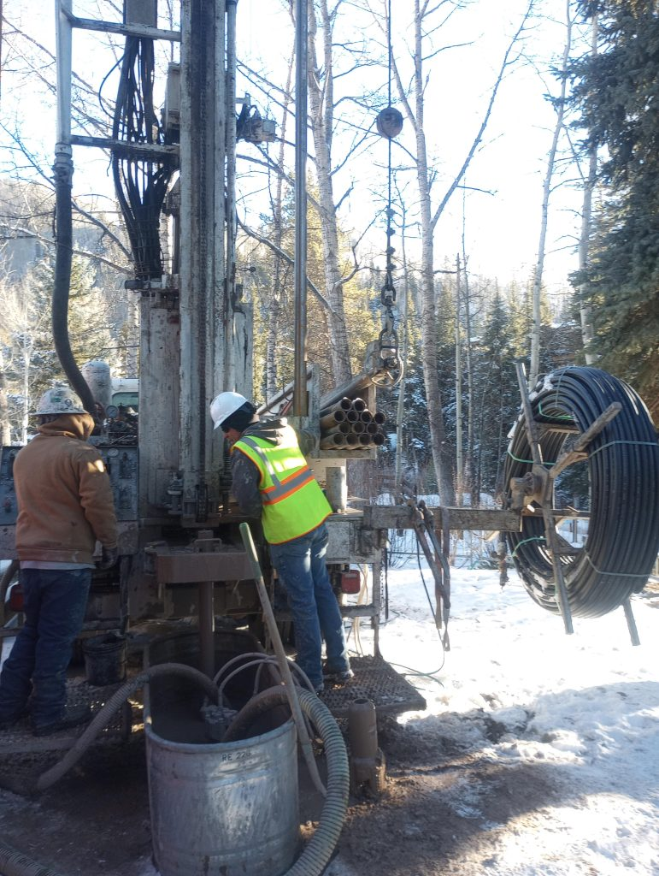
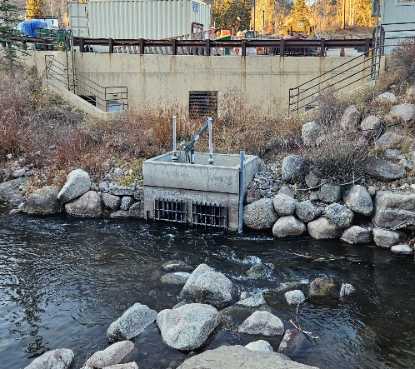
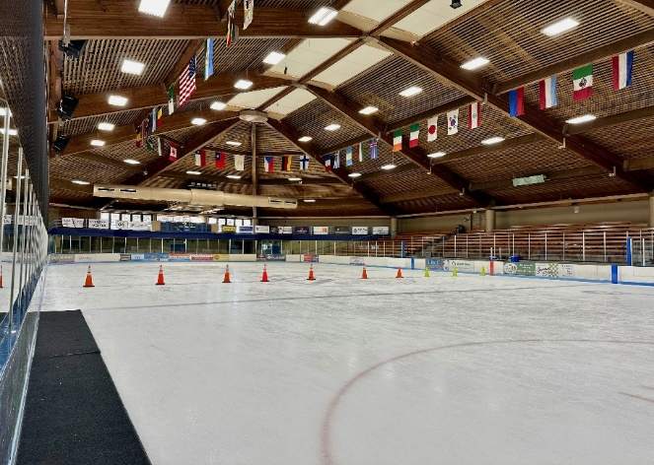
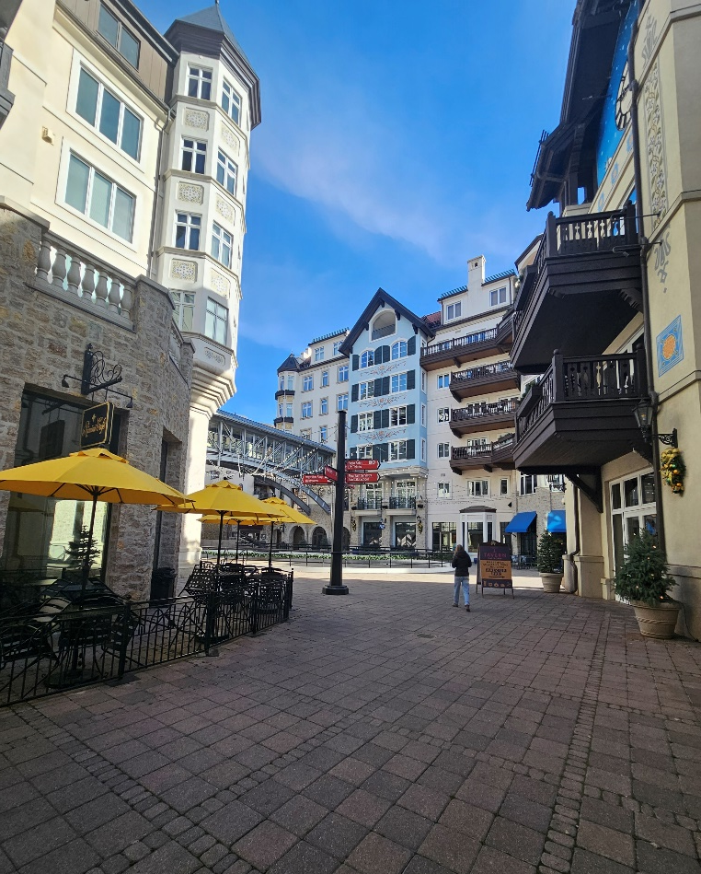
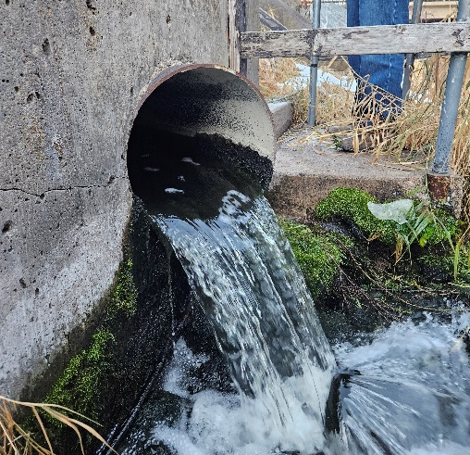
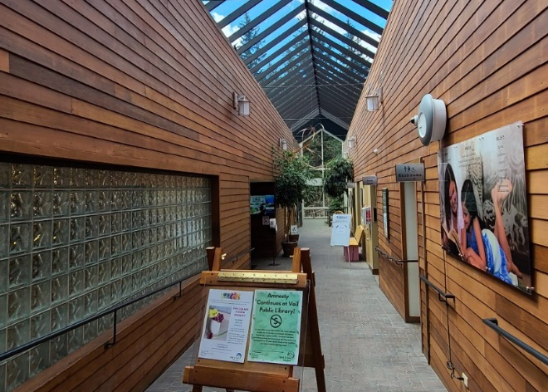
Potential Thermal Management Assets in Vail
Notes:
Partnership w/VR, ERWSD, Arrabelle has a 900 gpm dewatering system that could be a source of heat for the system. ERWSD treats up to 4million gallons daily and needs to reduce their temps under new state regulation. Creative solutions to heating involve taking advantage of existing waste heat opportunities (non-traditional waste-heat opportunities that can be capitizalized on with an TEN/ATL). (We will circle back to this on the paradigm shift slide). Are possible because of the nature of the TEN.

Slide 17

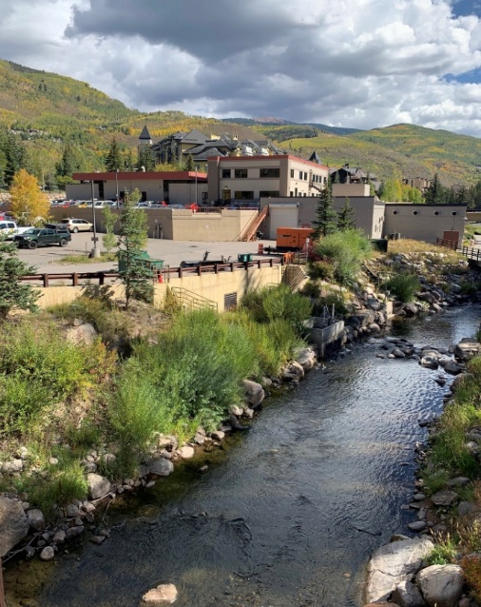
Geothermal Energy Grant Program: Phase II Award
Colorado Energy Office – 7 million grant round
Awarded TOV $250,000 for development of the Civic Area Geothermal Heating District, to include:
Wastewater treatment plant
Hotels like the Arrabelle
Library
Ice arena
Lionshead structure snowmelt plant
Geothermal Wells
Notes:
Grant will eneable work: Beginning work on: MEP Design, Civic planning, risk Mitigation, IRA implications, Business model

Slide 18
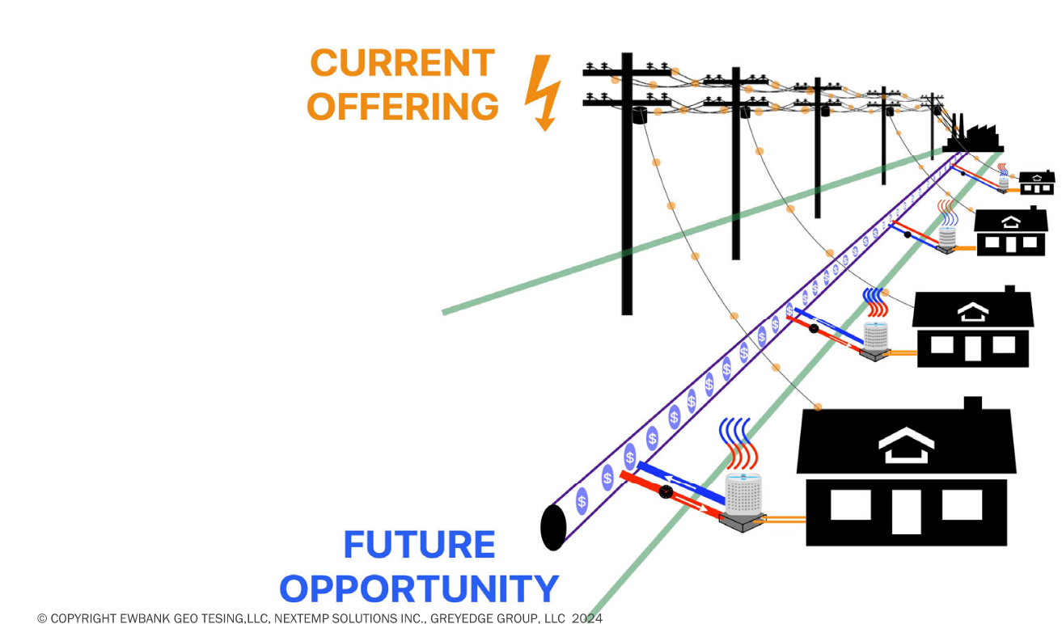
The Utility Thermal Energy Network (UTEN) Business Model
UTEN Conversation Evolving Nationally
Who Finances, Owns, and Operates?
Third Party
Municipality or Customers
Utility Company
Design, Commissioning and Controls Support
Billing and Customer Participation
Notes:
Reliability of service
Cost-effectiveness (affordability for rate payers)
Falcon-curve (concept of smoothing out seasonal and daily demand patterns
Buffering variability
Sustainability and decarbonization
Opportunity to expand business (electric and gas service territories, this is the gold rush for clean, affordable, reliable heating and cooling)

Slide 19
The Paradigm Shift
Beneficial Electrification is the challenge of our times- The last 10% is most difficult!
The TEN is a holistic tool to achieve decarbonization in the built environment
A TEN is a demand response tool that increases power factor of electrical grid
A TEN offers the highest possible COP for Heating and Cooling
In a TEN, liabilities can become assets
Notes:
Reiterate problem (evolving demands on electric grid + need to decarbonize thermal loads) – i.e. beneficial electrification
Decarbonizing 90%, last 10% is most difficult
A TEN is a holistic tool to manage the challenge of electrifying thermal loads at scale w/high penetration of renewables in energy supply
It is an interactive grid for heating and cooling
From liabilities to assets
Smoothing out demand curve
Higher COP for heat pumps
Higher efficiency
Stability
Coasting through demand events w/thermal mass
Reiterate problem (evolving demands on electric grid + need to decarbonize thermal loads) – i.e. beneficial electrification
Decarbonizing 90%, last 10% is most difficult
A TEN is a holistic tool to manage the challenge of electrifying thermal loads at scale w/high penetration of renewables in energy supply
It is an interactive grid for heating and cooling
From liabilities to assets
Smoothing out demand curve
Higher COP for heat pumps
Higher efficiency
Stability
Coasting through demand events w/thermal mass
Reiterate problem (evolving demands on electric grid + need to decarbonize thermal loads) – i.e. beneficial electrification
Decarbonizing 90%, last 10% is most difficult
A TEN is a holistic tool to manage the challenge of electrifying thermal loads at scale w/high penetration of renewables in energy supply
It is an interactive grid for heating and cooling
From liabilities to assets
Smoothing out demand curve
Higher COP for heat pumps
Higher efficiency
Stability
Coasting through demand events w/thermal mass

Slide 20


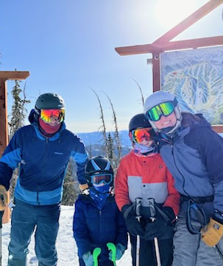
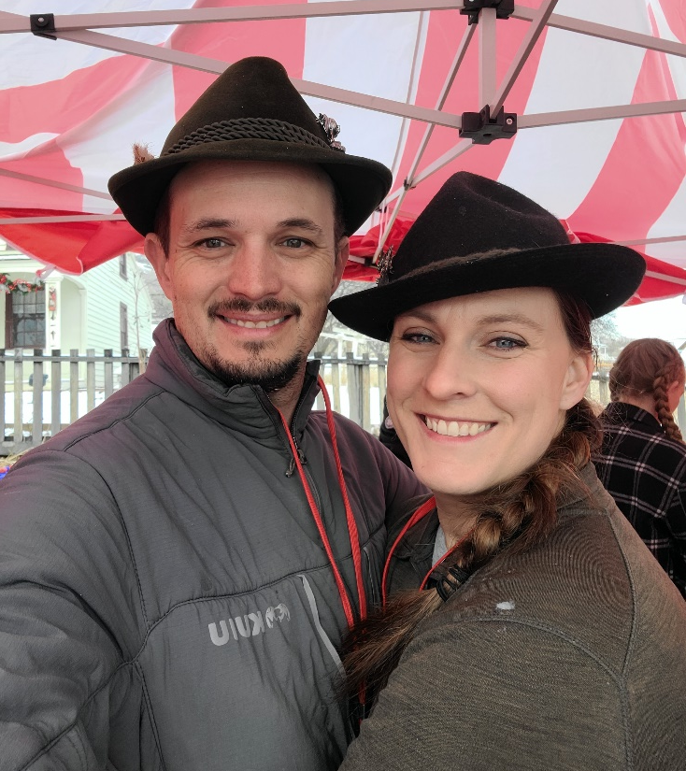

Thank you! Questions and Discussion
Cameron Millard
cmillard@vail.gov
Matthew Garlick
mgarlick@greyedgegroup.com

